Slide 1
CSCI 130 PROJECT
By
Sarika Tandale
Sindhura Yalamanchali
Yasasvi Yeleswarapu
Leeladhar Reddy Munnangi

Slide 2
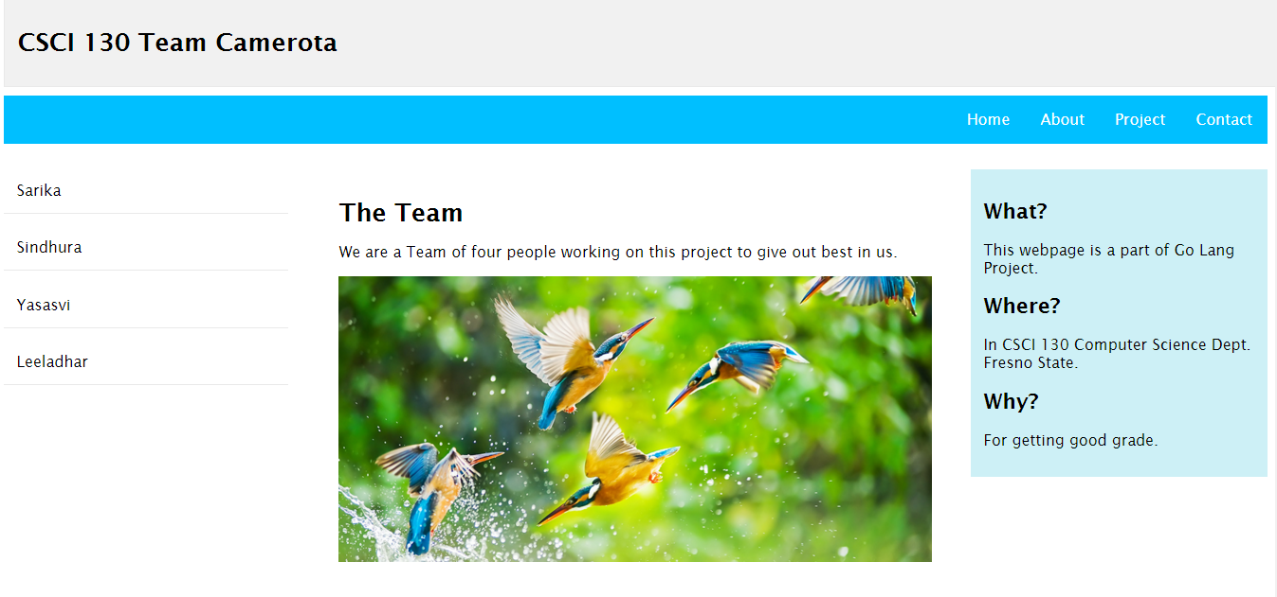

Slide 3
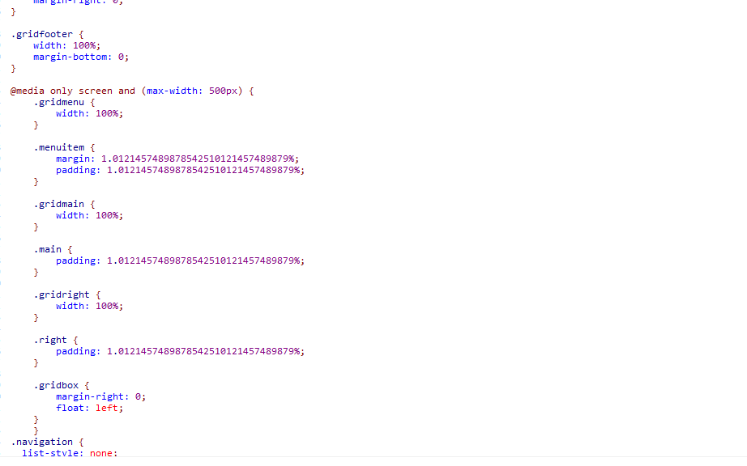

Slide 4
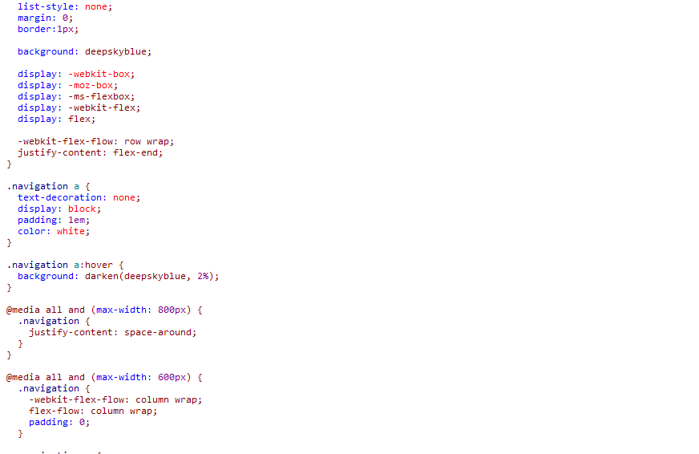

Slide 5
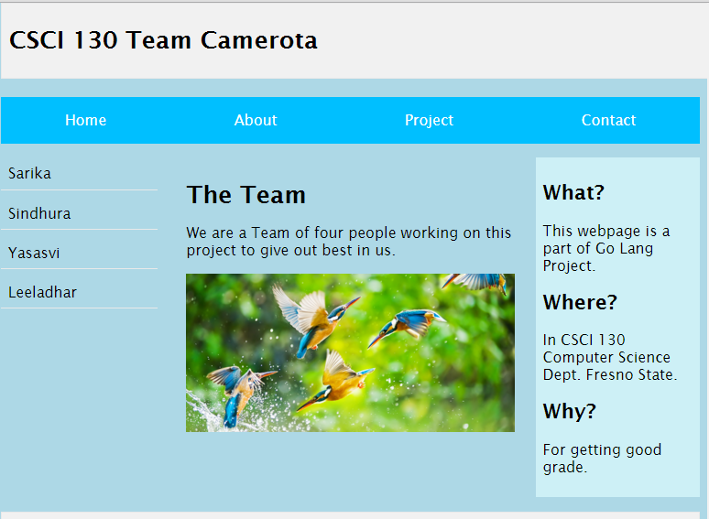

Slide 6
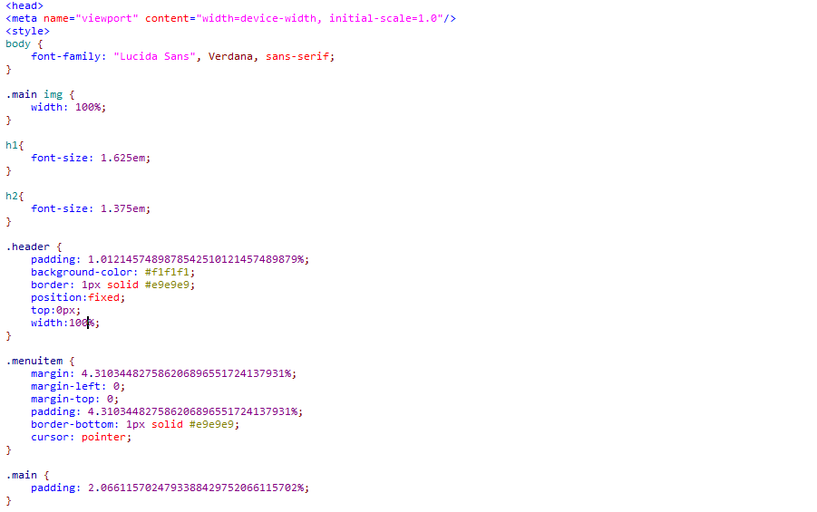

Slide 7
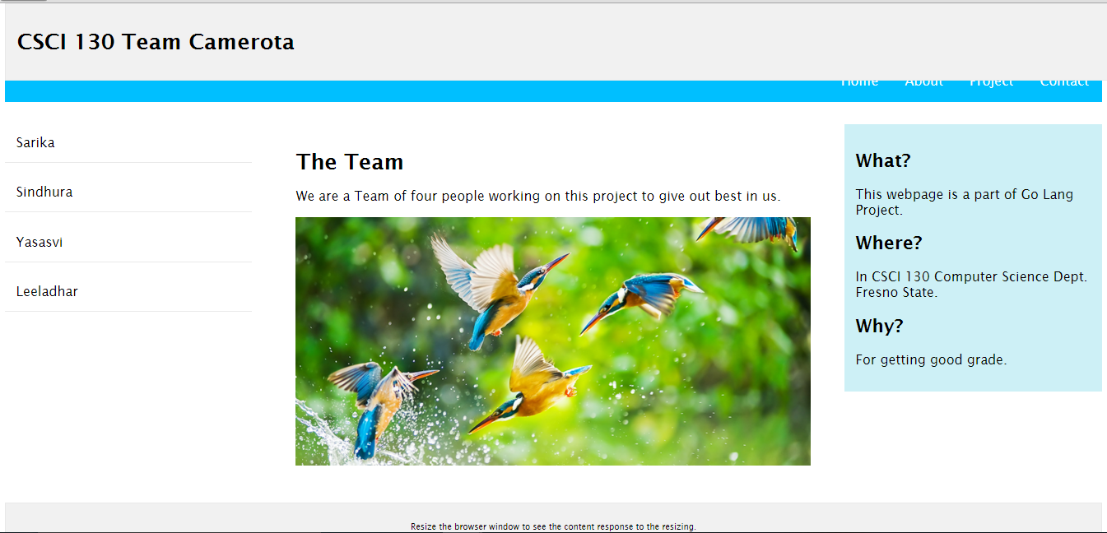

Slide 8
